Slide 1

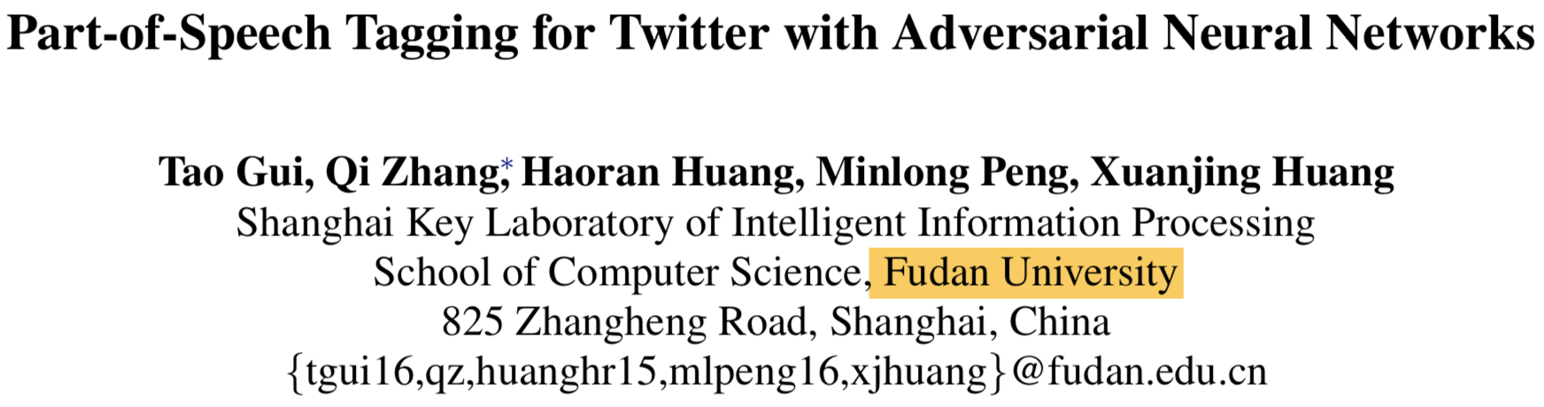

Slide 2
摘要
part- of-speech tagging for Tweets
use of out-of-domain labeled data, unlabeled in-domain data, and labeled in- domain data.
learn common features through adversarial discriminator.
adopts a sequence-to-sequence au- toencoder to preserve domain-specific features

Slide 3
摘要
Experimental results on three different datasets show that our method achieves better per- formance than state-of-the-art methods.

Slide 4
贡献
Target Preserved Adversarial Neural Network (TPANN)
incorporate large scale unla- beled in-domain data, out-of-domain labeled data, and in-domain labeled data for Twitter part-of-speech tagging task.
can learn domain-invariant representations

Slide 5
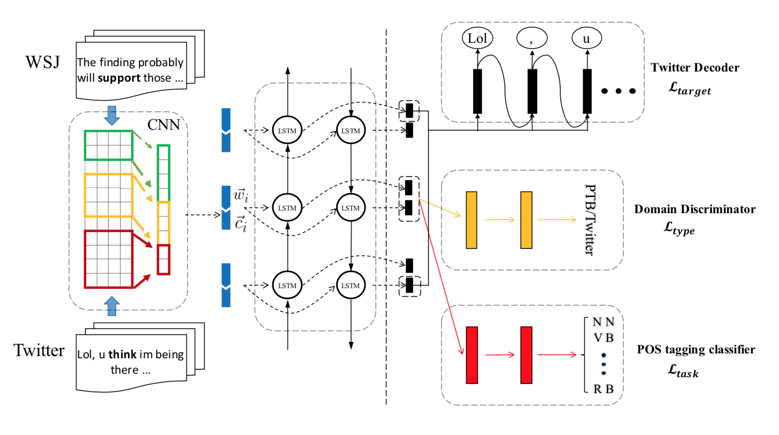

Slide 6
Method
利用标注规模大的新闻语料（Source）WSJ，来辅助Twitter 语料（Target）的POS标注
首先，利用不同窗口大小的CNN来学习字符表示，之后与词向量进行拼接，作为biLSTM的输入
基于Source语料训练POS分类器
之后，基于Source语料和Target语料，训练领域判别器Domain Discriminator
(minimizing the loss over θ_{d} while maximizing the loss over θ_{f} ?)
最后是基于target语料，拼接biLSTM前后向最后一个隐层的输出和前面的词向量，来训练自动编码机，学习领域私有特征

Slide 7
Experiments

